Slide 1

Online Library Management System
Presented By
Priyanka Bachar
ID: 20130101007
Dept. of CSE, BSMRSTU
Supervised By
Husnul Ajra
Lecturer,
Dept. of CSE, BSMRSTU

Slide 2
Outlines
Introduction
Motivation
Objectives
Methodology
Implementation
Resources
Conclusion
Future Work.
References

Slide 3
INTRODUCTION
The main objective of the library management system is organizing and managing the library tasks.
It is an information system which mainly focused on basic operations like adding new books in department wise, searching books, clients facility to borrow and register for new books.

Slide 4
MOTIVATION
In present state, library system is manual. It is wastages our time.
Online book issue. Improvement in control and performance.

Slide 5
OBJECTIVES
To eliminate the paper-work in library.
To arrange all the books in department wise and one can search any book.
To send notification to the clients to remainder about the validation time.
To record every transaction in computerized system.

Slide 6
METHODOLOGY
(User Flow Chart)
start
Log In
Search Book
Notification
And fee
No
Get info
Timely
Return ?
End
borrow
Yes

Slide 7
CONTINUE…….
Admin Flow Chart
Start
End
I/U/D
Admin
Book Database
Login

Slide 8
CONTINUE…….
This system contains list of all the books in department wise.
This project will be developed by using android studio(java, xml), SQLite.
Using this system users can issue book to the library member, maintain their records, and can checks how many books are available in the library.

Slide 9
CONTINUE…….
Using this system, user can get any books easily.
User can search for books and borrow book.

Slide 10
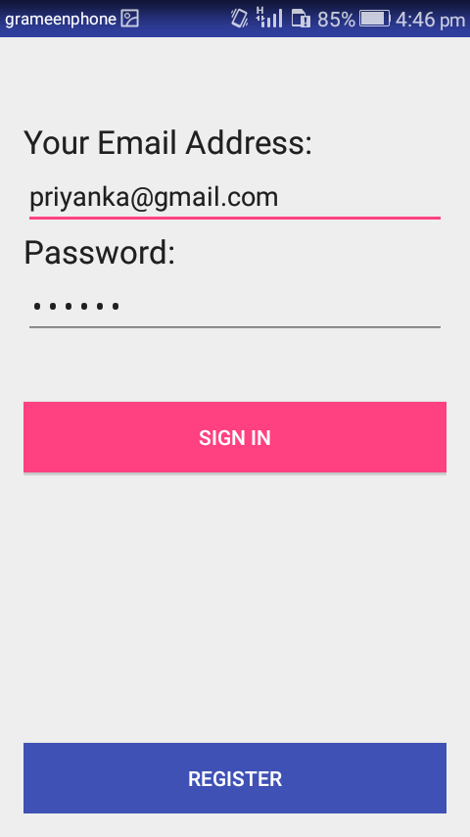
IMPLEMENTATION
Login page
At first user have to login to enter the system. They are required to key in the user id and password before they are allows entering the system

Slide 11
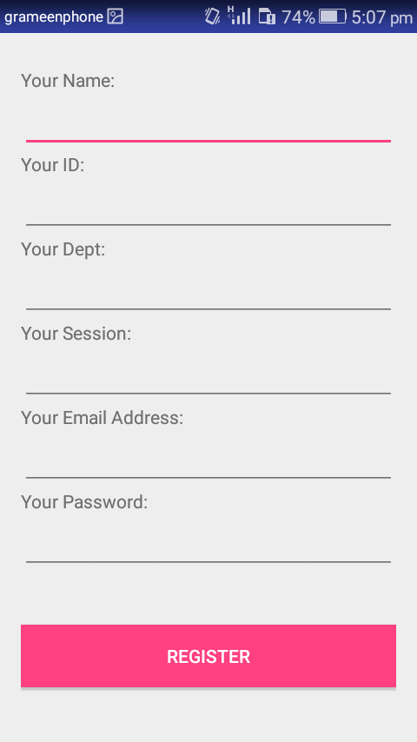
CONTINUE….
Register New Books
This feature can be performing by all users to register new book to the library.

Slide 12
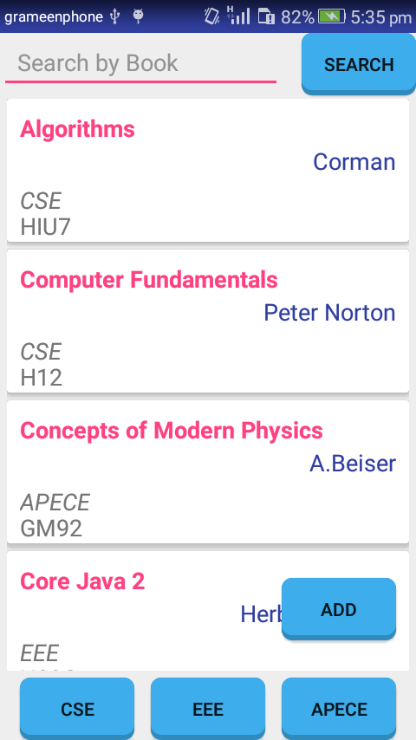
CONTINUE….
List of Books
A book is a series of pages. This is a list of books in a library. User can get all available books in library.

Slide 13
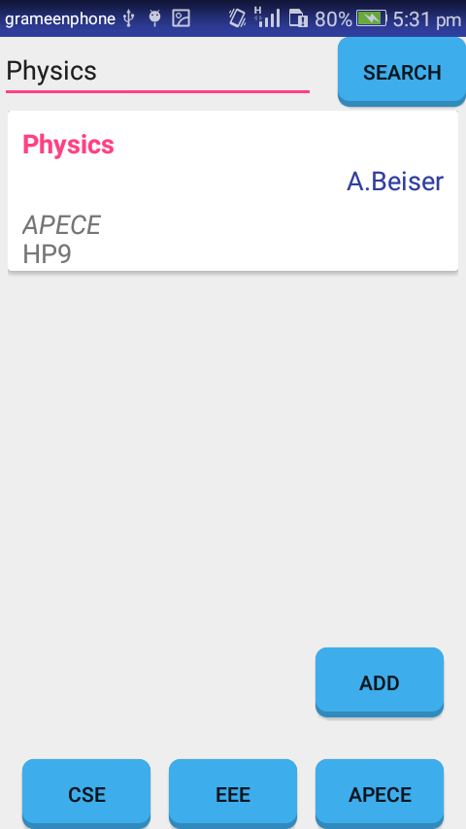
CONTINUE….
Search Book
This feature is found at book maintenance part. User can search book based on book title of first name.

Slide 14
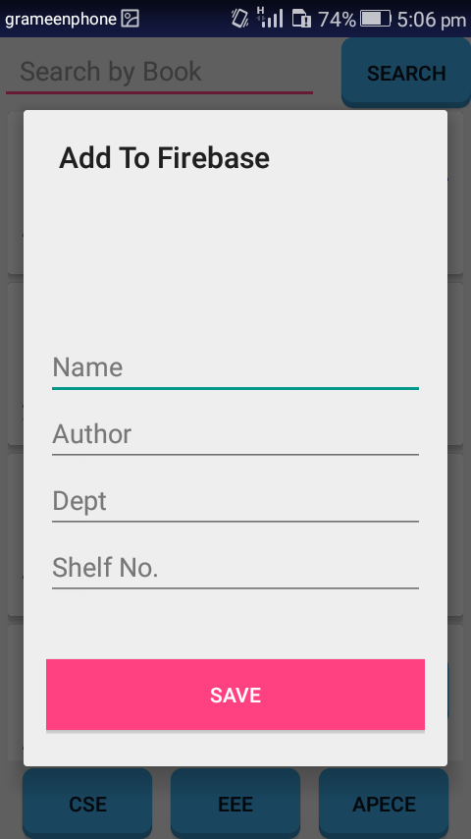
CONTINUE....
Add Books
To add new books in library based on book name, author, dept and shelf no. in the following figure:

Slide 15
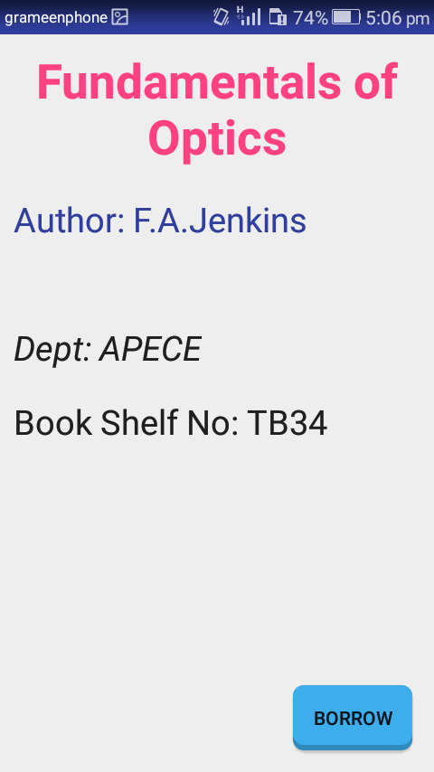
CONTINUE…..
Borrow books
When user want to borrow books, click in the following figure:

Slide 16
CONCLUSION
The Library Management System was developed to replace the manual process of arranging books and other information.

Slide 17
FUTURE WORK
In future we make this project more secure and more efficient. After analyzing the results of the developed systems, the following issues are still open which can be taken up as future enhancements.. In future I will try my best to add notification system.

Slide 18
REFERENCES
[1] C. J. M. L. M. Eliassen, R. Saetre, and B. Gamback,” real time information in an intelligent smartphone application,” in Gesellschaft fir Informatik eV(GI) publishes this series in order to make available to a broad public recent findings in informatics (ie computer science and information systems), to document conferences that are organized in co-operation with GI and to publish the annual GI Award dissertion. Citeseer, 2012, p. 48.
[2] Y. Sardey, P. Deshmukh, P. Mandilk, S. Shelar, and M. Nerkar,”A mobile application for library management system,”Institute of Information Technology, Department of Computer Science, Pune, India,2014.

Slide 19
THANKS TO ALL

